Slide 1
Introduction to Quantum Computing: From a Layperson to a Programmer in 30 Steps
Hiu-Yung Wong
https://link.springer.com/book/10.1007/978-3-030-98339-0
https://www.amazon.com/Introduction-Quantum-Computing-Layperson-Programmer/dp/3030983382
Playlist: https://www.youtube.com/watch?v=E2_2kUnKofA&list=PLnK6MrIqGXsJfcBdppW3CKJ858zR8P4eP&index=21
https://www.youtube.com/watch?v=wWQv17dyias&list=PLnK6MrIqGXsJfcBdppW3CKJ858zR8P4eP&index=22
https://www.youtube.com/watch?v=8u2axTF68EM&list=PLnK6MrIqGXsJfcBdppW3CKJ858zR8P4eP&index=23
https://www.youtube.com/watch?v=bfoVulxgYGg&list=PLnK6MrIqGXsJfcBdppW3CKJ858zR8P4eP&index=24
https://www.youtube.com/watch?v=kbjG9v1T-k8&list=PLnK6MrIqGXsJfcBdppW3CKJ858zR8P4eP&index=25

Slide 2

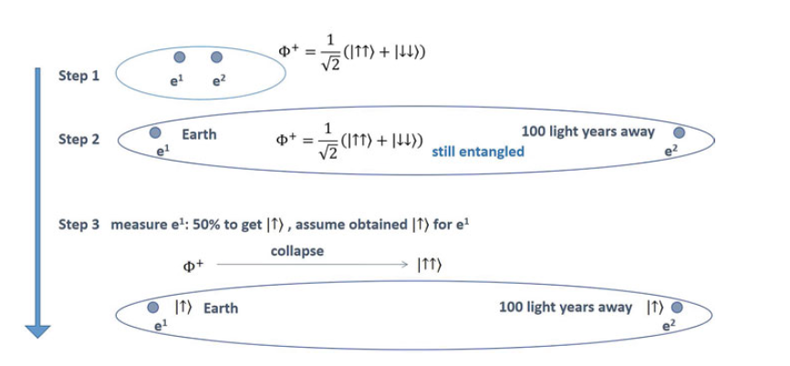
What does it mean when it is entangled?

Slide 3
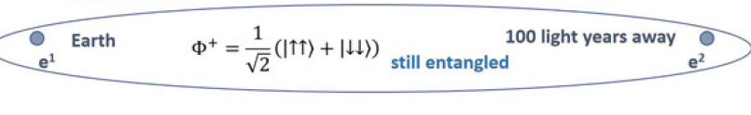
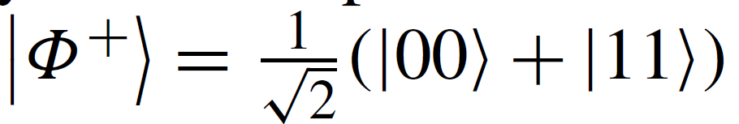
EPR Paradox (Einstein, Podolsky, Rosen)
A
B
B decides to perform a measurement in the |+ ⟩ / |− ⟩ basis. We know |0 = 1/ √2 (|+ ⟩ + |− ⟩). So the
electron must collapse to either |+ ⟩ or |− ⟩ . Assume it collapses to |+ ⟩ .
B also knows with a 100% certainty that the electron is in the |+ ⟩ state.
Now B knows with 100% certainty that the electron is in the |+ ⟩ and |0 ⟩ states.
A measure electron in the |0⟩ / |1⟩ basis
Assume A get |0 ⟩ Then the state of the two-electron
system becomes |00⟩
100 percent certain that B is zero due to entanglement
Conclusion :- Quantum Mechanics is wrong or Incomplete

Slide 4
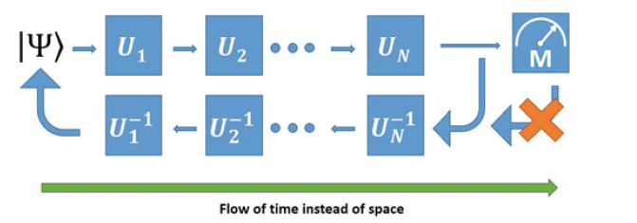
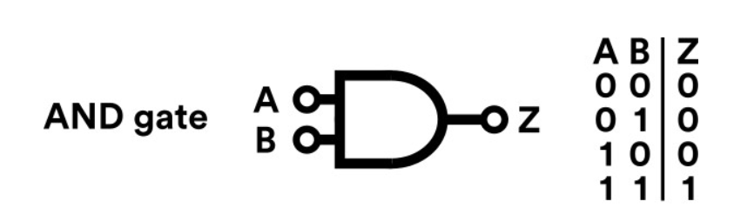
What is Quantum Computing again?
Quantum Computation is a unitary transformation where a measurement is performed at the end to extract the result.
Quantum Computing
classical
Irreversible

Slide 5
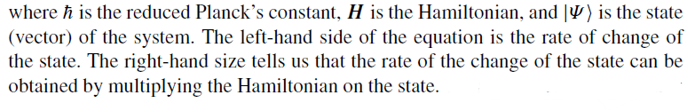


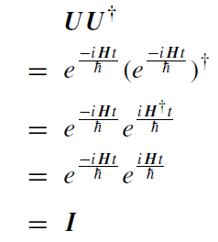
Why Unitary (besides preservation of inner product)?
Quantum Mechanics State Evolution is Unitary!
H, which is the operator for

Slide 6














NOT (X) Gate
Define a gate by how it transforms basis vector
Definition
General state
Not gate is Unitary

Slide 7
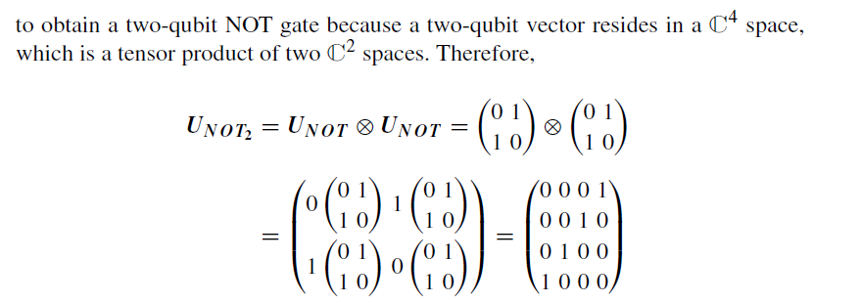
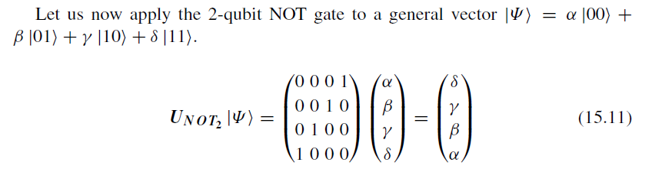
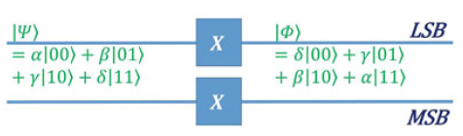
NOT for 2 qubit

Slide 8

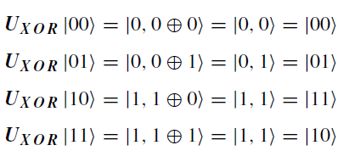

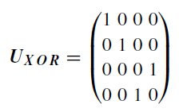
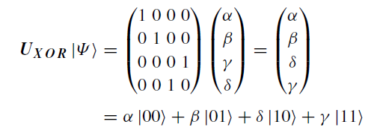
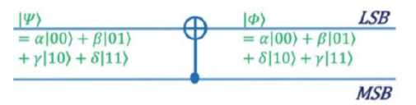
XOR (CNOT) Gate (2-qubit)
Definition
Control Qubit
Target Qubit

Slide 9
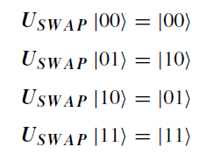

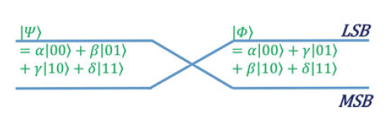
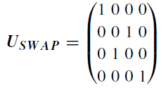
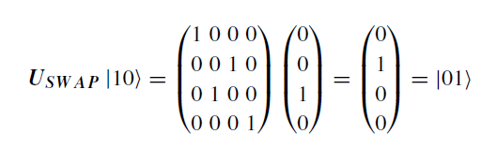
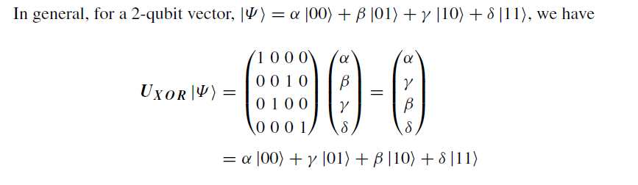
Exchange (SWAP) Gate
Definition

Slide 10





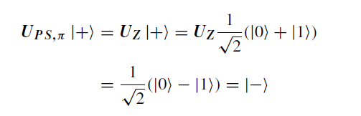
1-Bit Phase Shift Gate
Definition
And this is just the σz matrix, one of the important Pauli matrices. And it is also called the Z-gate.

